Slide 1



Presented By : Priya Agrawal

Slide 2
Introduction
Atliq Hardware, a leading computer hardware manufacturer in India with a global customer base, aims to gain insights into product sales to support data-driven decision-making.
Problem Statement
The management realized they lack enough insights to make quick and smart decisions.
To fix this, they plan to grow their data analytics team by hiring more junior data analysts.
Tony Sharma, the data analytics director, is looking for candidates with both technical and soft skills.
Objectives
The primary objectives of the project are:
Problem Solving: To address 10 ad-hoc business requests by querying and analyzing the provided datasets.
Stakeholder Communication: To present findings in a professional and stakeholder-friendly format, ensuring clarity and relevance for top-level management.
Technical Proficiency: To demonstrate a deep understanding of SQL, including querying, aggregating, and manipulating data. Power BI tool is used for data visualization and present insights.
Strategic Thinking: To apply data analysis to solve real-world business challenges and propose data-informed recommendations for executive decision-making.

Slide 3
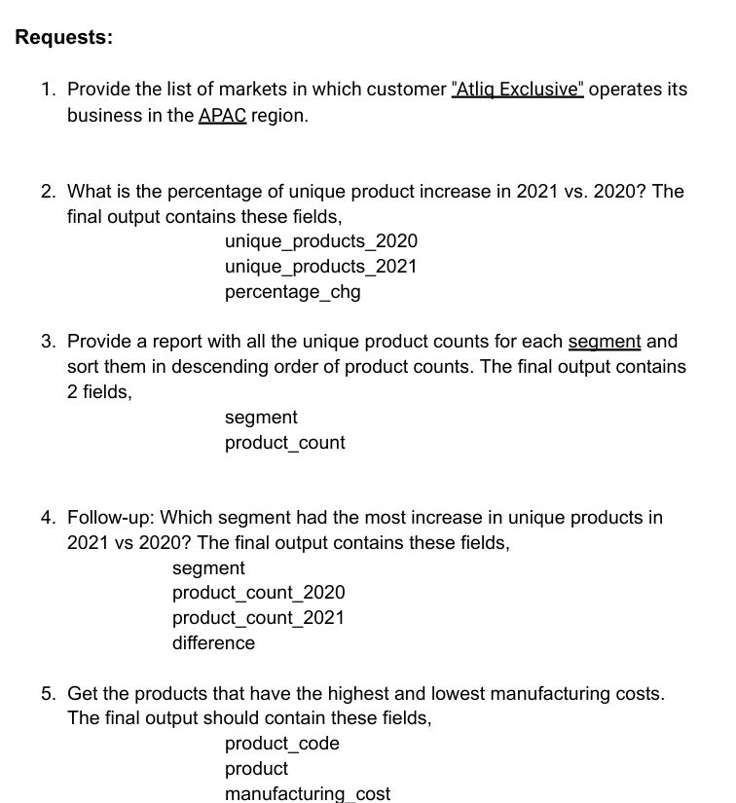


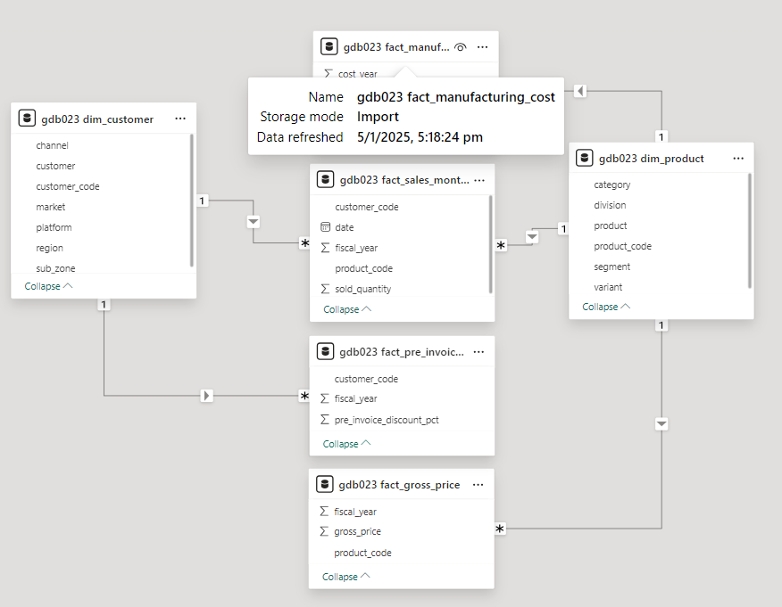
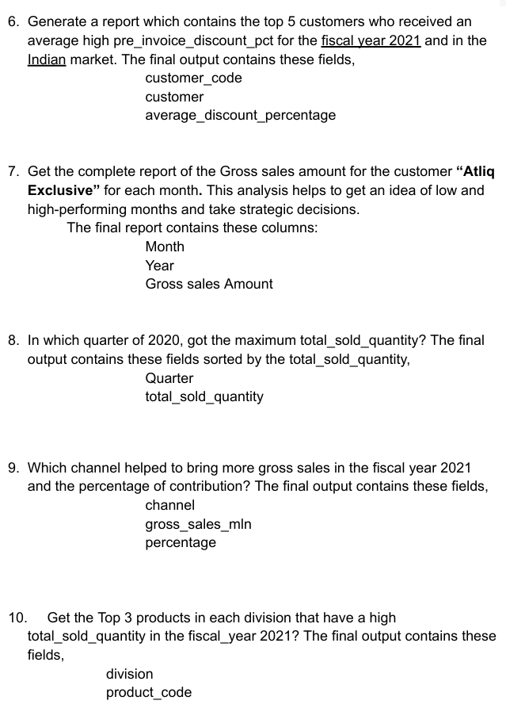
Ad-Hoc Requests and Tools

Slide 4
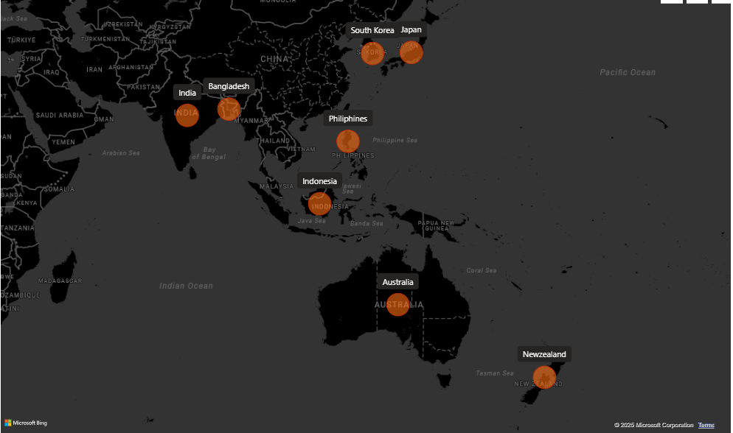
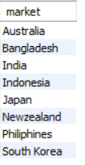


1. Provide the list of markets in which customer "Atliq Exclusive" operates its business in the APAC region.

Slide 5
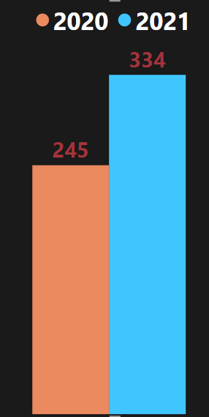
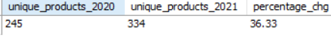
2. What is the percentage of unique product increase in 2021 vs. 2020?
The final output contains these fields:
unique_products_2020 ,unique_products_2021,
percentage_chg
36.33 %
Insight:
The percentage increase from 2020 to 2021 is 36.3%. So we can say demand and production both are increased in 2021.

Slide 6
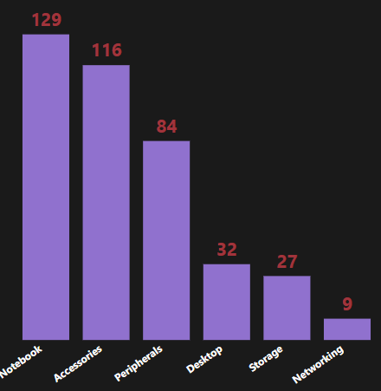
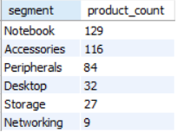
3. Provide a report with all the unique product counts for each segment and sort them in descending order of product counts.
The final output contains 2 fields:
segment, product_count

Slide 7
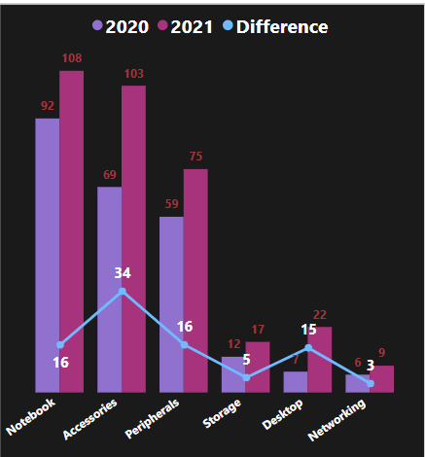
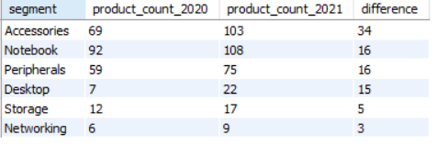
4. Follow-up: Which segment had the most increase in unique products in 2021 vs 2020?
The final output contains these fields:
Segment, product_count_2020,
product_count_2021 difference
Insight:
Accessories shows the most demands and production in 2021 as compare to other segment.
Storage and networking shows the slowest growth.

Slide 8

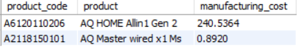

5. Get the products that have the highest and lowest manufacturing costs.
The final output should contain these fields:
product_code, product, manufacturing_cost
Product with Max Manufacturing cost
- AQ Home Allin1 Gen2
Product with Min Manufacturing cost
- AQ Master Wired X1 MS
Computer icons created by Freepik - Flaticon

Slide 9
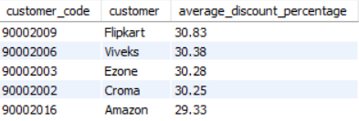
6. Generate a report which contains the top 5 customers who received an average high pre_invoice_discount_pct for the fiscal year 2021 and in the Indian market.
The final output contains these fields:
customer_code, customer, average_discount_percentage
Insight:
The maximum pre_invoice_discount was given to flipkart.
The minimum pre_invoice_discount was given to Amazon.

Slide 10
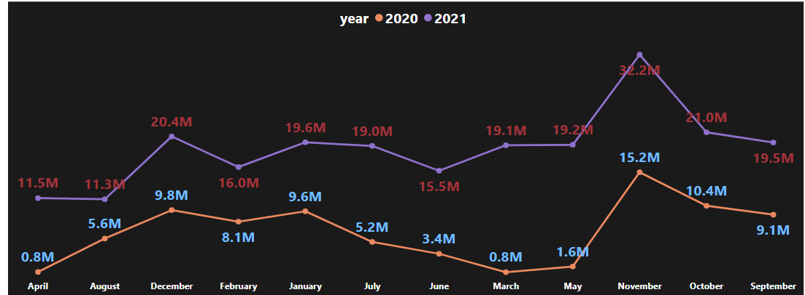
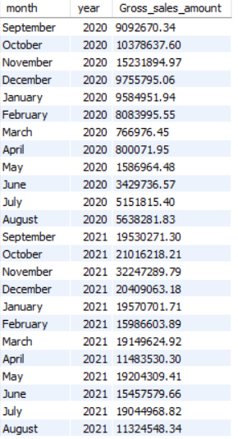
7. Get the complete report of the Gross sales amount for the customer “Atliq Exclusive” for each month . This analysis helps to get an idea of low and high-performing months and take strategic decisions.
The final report contains these columns: Month, Year, Gross sales Amount
Insights:
The lowest Gross Sales Amount is in FY 2020 march.
The highest Gross Sales Amount is in November of both Fiscal year.

Slide 11
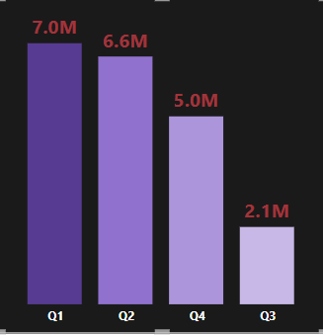
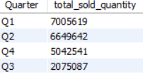
8. In which quarter of 2020, got the maximum total_sold_quantity?
The final output contains these fields sorted by the total_sold_quantity:
Quarter, total_sold_quantity
Insights:
Q1 shows the maximum total_sold_quantity.
Q3 shows the minimum total_sold_quantity.
Q1 - September, October, November
Q2 – December, January, February
Q3 – March, April, May
Q4 – June, July, August

Slide 12
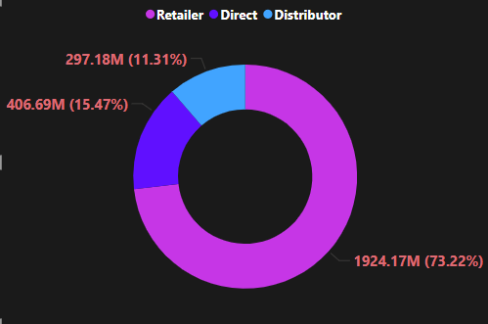
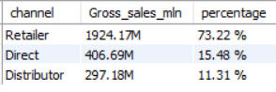
9. Which channel helped to bring more gross sales in the fiscal year 2021 and the percentage of contribution?
The final output contains these fields:
channel, gross_sales_mln,
percentage
Insights:
Retailer helped to bring the maximum gross sales (73.22%).
Distributer makes the least contribution in gross sales (11.31%).

Slide 13
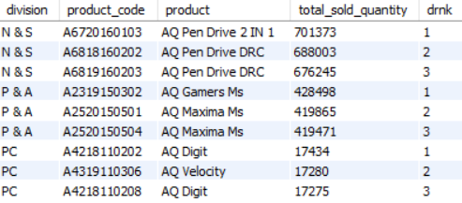
10. Get the Top 3 products in each division that have a high total_sold_quantity in the fiscal_year 2021?
The final output contains these fields:
division, product_code, product, total_sold_quantity, rank_order
Insights:
Each division has a product with variations that show up twice in the top three products for that division.

Slide 14
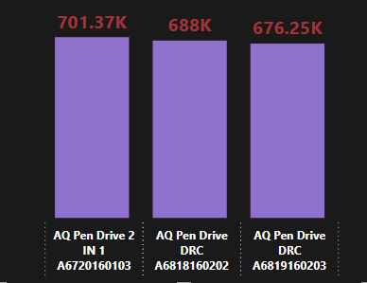



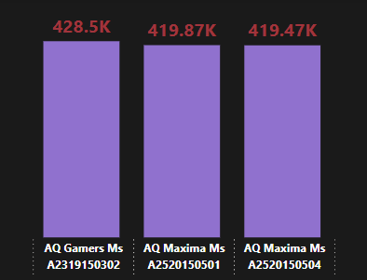
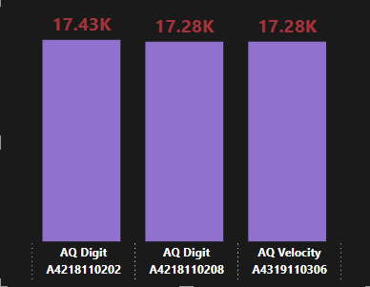
Division: N & S
Division: P & A
Division: PC
Premium
Plus
Premium
Standard 2
Plus 2
Standard 1
Standard Blue
Premium Misty Green
Plus Red

Slide 15


